Slide 1




Weather Monitoring Application Using Spring Boot
SDP – 3 | Review - 1

Slide 2
Understanding Problem Statement [SDP3-PS39]
We have to define the present climate, but also for detecting changes in climate and forecasting of approaching dangerous weather like storms, cyclones, floods and keeps track of weather day to day and alert for any natural calamities.
Guide and help the user based on the climate and change in weather.

Slide 3
Finalization of Solution
Collection the user information with privacy policy and with knowledge. With the help of it we can recommend the alert the user what things to be followed and the safety precautions to be taken.
We have to define the present climate, but also for detecting changes in climate and forecasting of approaching dangerous weather like storms, cyclones, floods and keeps track of weather day to day and alert for any natural calamities.

Slide 4
Objective
Weather Monitoring Application which is being built by using Spring Boot. This application can be used to define the present climate, but also for detecting changes in climate and forecasting of approaching dangerous weather like storms, cyclones, floods and keeps track of weather day to day and alert for any natural calamities.

Slide 5
Requirements Specifications
SpringToolSuite4
MySQL 8
Java 11
Tomcat Server – which will be inside the spring boot. So, No need to install in our system.
Weather API
Browser

Slide 6
Modules Identification
Non – Session User: Without Login the user can avail the weather monitor application.
Session User: This user can avail more features than a non - session user. Where based on their information, alerts messages will be sent to them. And Guide and help the user not to waste their time at horrible climate and weather.
Weather API: Based on the user location the live weather API will provide the accurate climate and weather info. to the user.

Slide 7
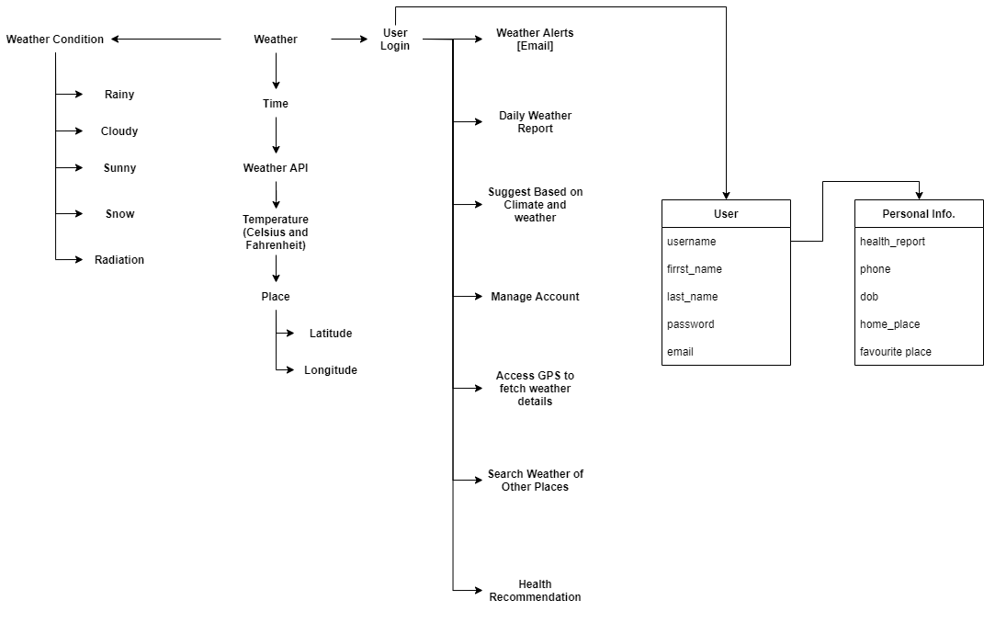
Identification of Use cases for every module

Slide 8

Project Team No. - PM14 Project Team Name - SDP3-ClusterPM-PM14
N Sai Akhil Kumar Reddy [190031153] [Team Lead] N V N S Pavan Radha Krishna Kumar [190031134]

